Slide 1
Comparative Sentiment Analysis on Twitter Data using SVM, RandomForest, Vader, and Bert Models
By:
Thilok Reddy Anugu, Sree Chandana Kurella and Vineela Velaga

Slide 2
Contents
Abstract
Introduction
Literature Survey
Approach & Implementation
Experiments & Observations
Conclusions / Roadmap
References

Slide 3
Abstract
This project presents a comparative analysis of sentiment analysis on Twitter data using distinct models, including Support Vector Machines (SVM), Random Forest Classifier, Vader, and Bert. Each model is applied independently to capture diverse aspects of sentiment expression on social media. The study encompasses preprocessing techniques, such as text mining, Stopwords removal, and evaluates the performance of each model. The results provide insights into the strengths and limitations of individual models, contributing to a comprehensive understanding of sentiment analysis on Twitter.

Slide 4
Introduction
Sentiment analysis has become increasingly crucial in understanding public opinion, especially with the wealth of data available on social media platforms like Twitter.
In our project, we focus on Twitter data, employing various models—SVM, Random Forest, VADER, and BERT—to analyze sentiments efficiently.
Our goal is to extract valuable knowledge from Twitter feeds
Through our comparative study, we aim to determine the most effective model for sentiment

Slide 5
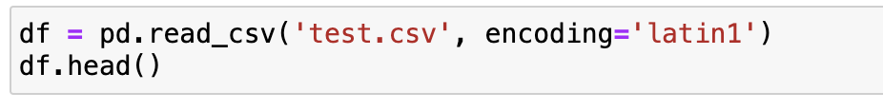
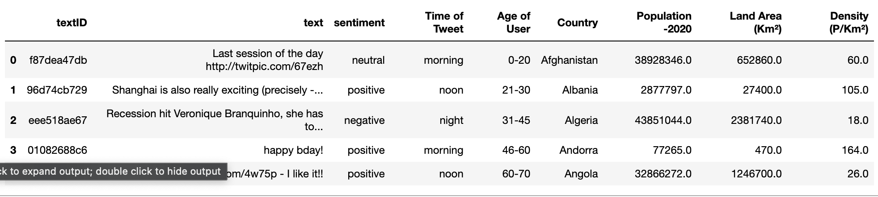
The dataset

Slide 6
Literature Survey
Twitter Sentiment Analysis Approaches
Researchers have devised diverse approaches tailored to the unique characteristics of Twitter data. Notably, Wang et al. [1] developed a real-time Twitter sentiment analysis system focused on the 2012 U.S. Presidential Election cycle. Their work demonstrated the feasibility of capturing dynamic sentiment trends during significant events.
Adwan et al. [3] conducted a comprehensive survey of Twitter sentiment analysis approaches, providing insights into the evolution of methodologies. Their work serves as a valuable reference for understanding the landscape of sentiment analysis on Twitter.
Advances in Deep Learning and BERT Model
Recent advancements in deep learning, especially the introduction of BERT (Bidirectional Encoder Representations from Transformers), have revolutionized sentiment analysis. Koroteev [2] provided a thorough review of BERT's applications in natural language processing, offering a comprehensive understanding of its capabilities.
Hybrid Learning for Recommender Applications
Gandhe et al. [4] explored hybrid learning approaches for sentiment analysis of Twitter data, specifically focusing on recommender applications. Their work contributes to the understanding of how hybrid learning techniques can enhance sentiment analysis accuracy and relevance.
Machine Learning Classifiers Primer
Ahad et al. [5] presented a primer on machine learning classifiers, providing foundational knowledge essential for understanding the underlying principles of sentiment analysis models. This primer serves as a valuable resource for researchers and practitioners delving into the field of machine learning.
Survey on Twitter Sentiment Analysis Approaches
A comprehensive survey by Adwan et al. [3] provides a detailed exploration of various Twitter sentiment analysis approaches. This survey covers a wide spectrum of methodologies, offering a holistic view of the existing landscape and paving the way for our comparative analysis.

Slide 7
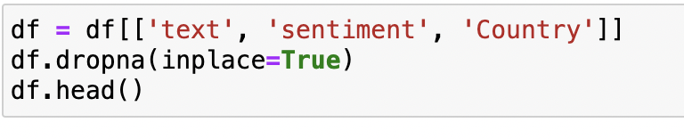
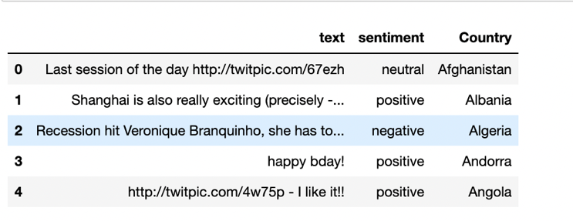
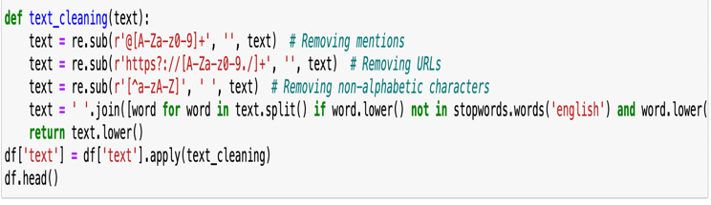
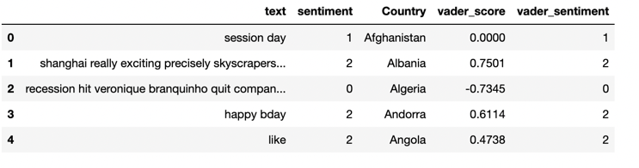
Approach & Implementation
Data Preprocessing
Data preprocessing is a crucial step to ensure the quality of the Twitter data for effective sentiment analysis. The preprocessing steps include:
Text Cleaning: Removal of mentions, URLs, and non-alphabetic characters from the tweets.
Stopword Removal: Elimination of common and custom stopwords to filter out noise.

Slide 8
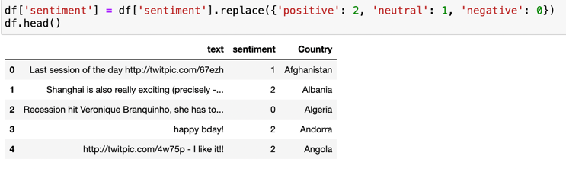
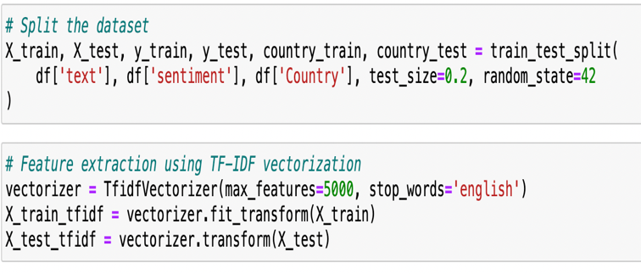
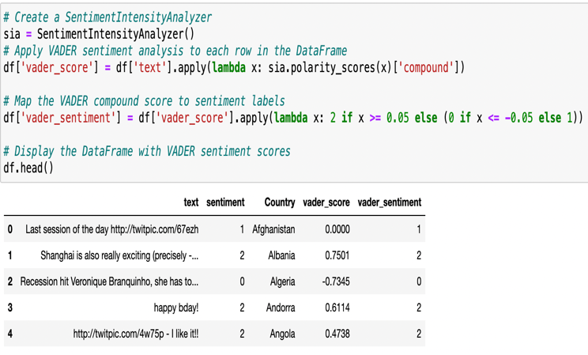
Approach & Implementation
Sentiment Labeling
A three-class sentiment labeling scheme was adopted for supervised learning: 0 for negative, 1 for neutral, and 2 for positive sentiment.
Feature Extraction
VADER Sentiment Analysis: Integration of the VADER tool for sentiment analysis, assigning compound scores to tweets based on predefined thresholds.
TF-IDF Vectorization: Utilization of TF-IDF (Term Frequency-Inverse Document Frequency) vectorization for converting preprocessed text data into numerical features, capturing term importance relative to the entire dataset.

Slide 9
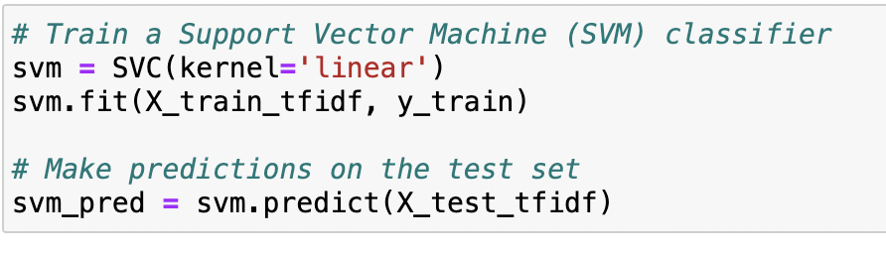
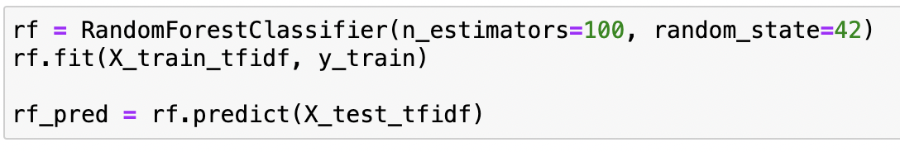
Approach & Implementation
Model Selection
Support Vector Machine (SVM): Employment of a linear Support Vector Machine (SVM) as a primary classifier due to its effectiveness in handling high-dimensional data. SVM identifies the optimal hyperplane for separating data into distinct sentiment classes.
Random Forest Classifier: Utilization of the Random Forest Classifier, an ensemble learning method, to harness the collective predictive power of multiple decision trees. This approach enhances model robustness and generalizability.
BERT Model: Integration of the BERT model, a powerful transformer-based architecture, for enhanced sentiment analysis. The BERT model achieved a notable accuracy of 79%, surpassing other models.

Slide 10
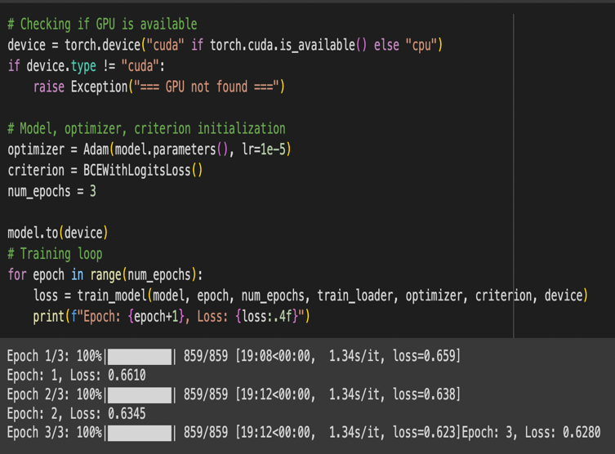
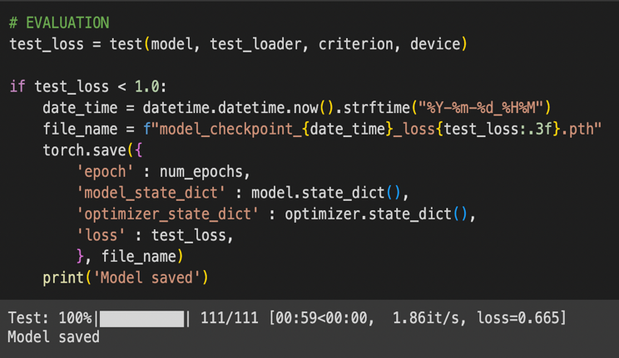
Approach & Implementation
BERT

Slide 11
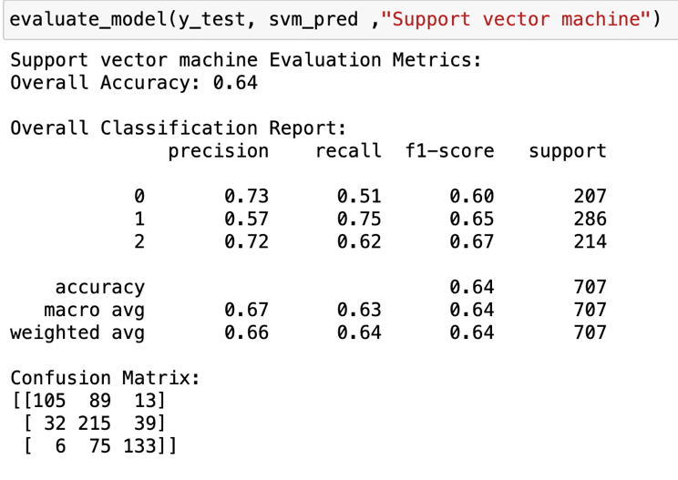
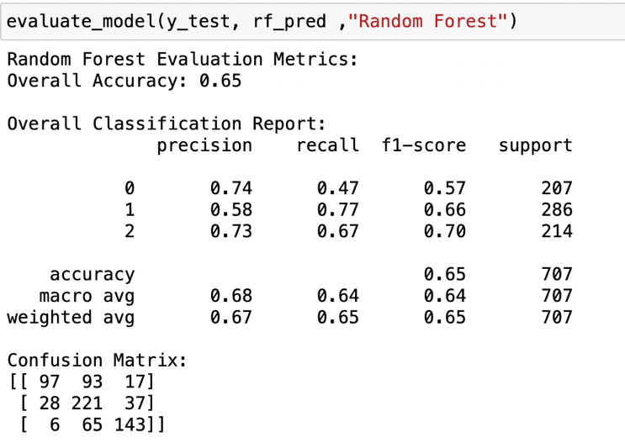
Experiments & Observations
Model Evaluation:
Support Vector Machine
Random Forest Classifier

Slide 12
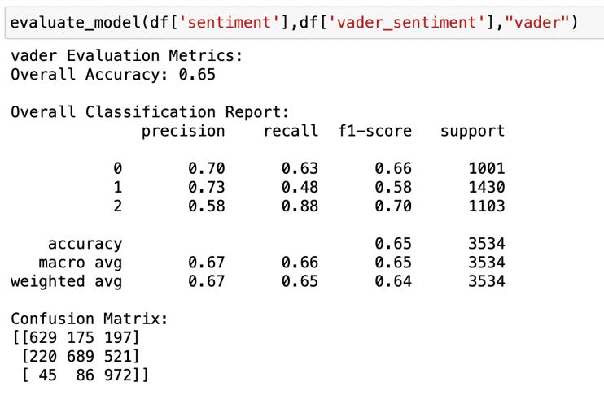
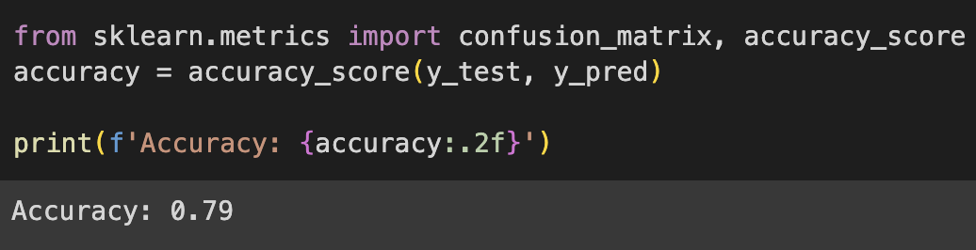
Experiments & Observations
VADER
BERT

Slide 13
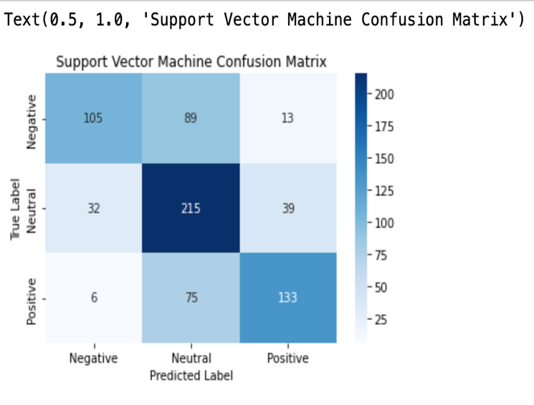
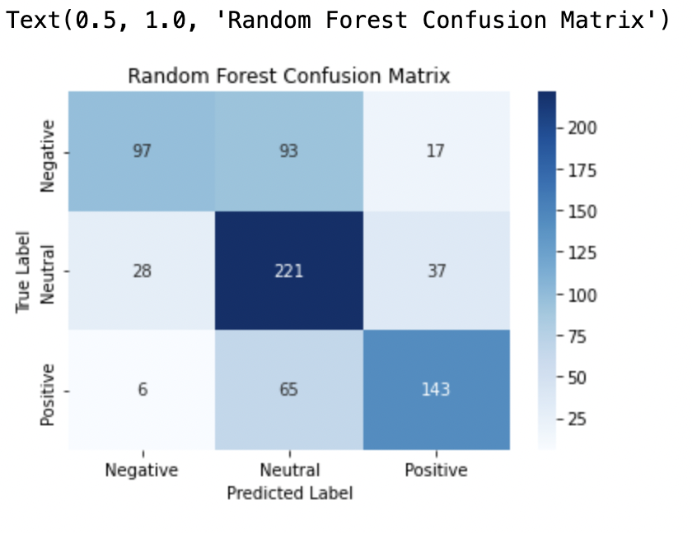
Experiments & Observations
Confusion Matrix
Support Vector Machine
Random Forest Classifier

Slide 14
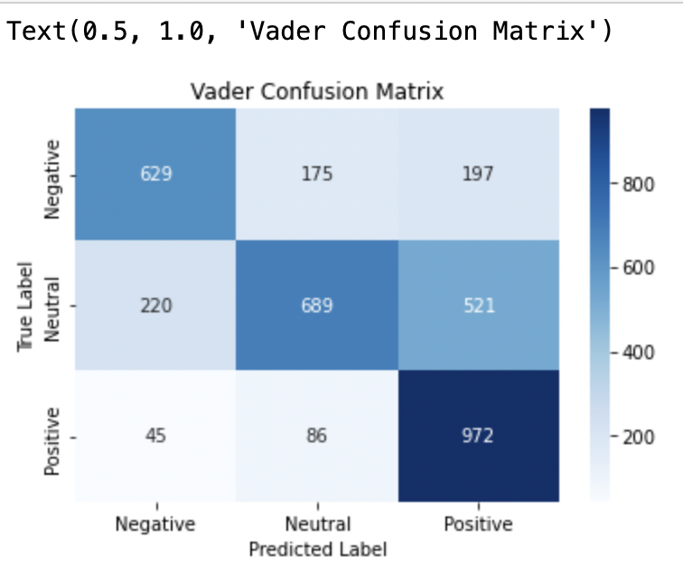
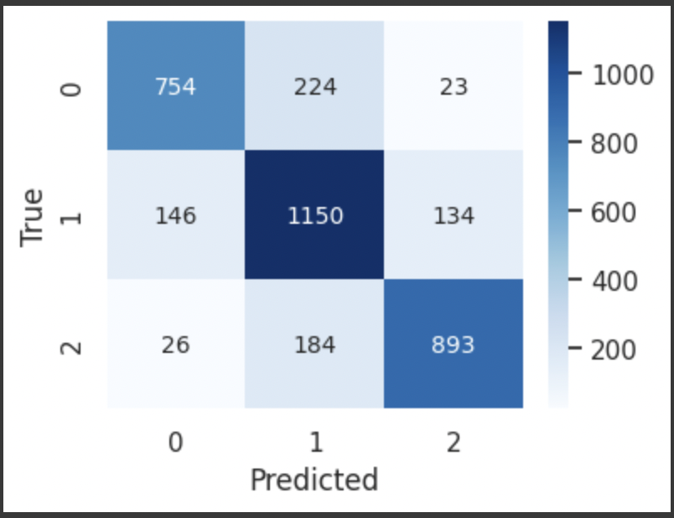
Experiments & Observations
VADER
BERT

Slide 15
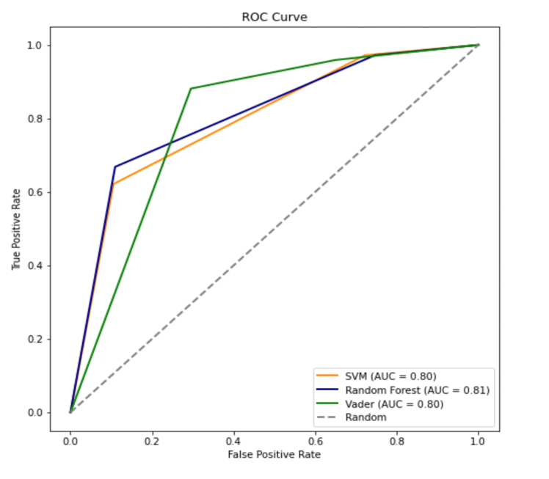
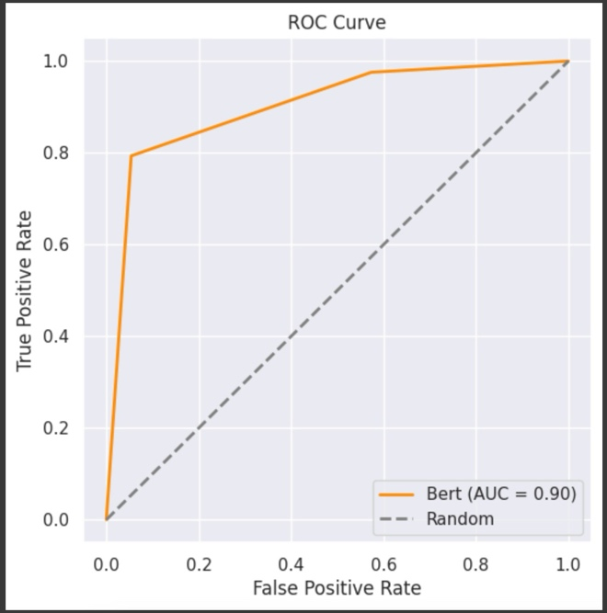
Experiments & Observations
ROC AUC Curves
BERT

Slide 16
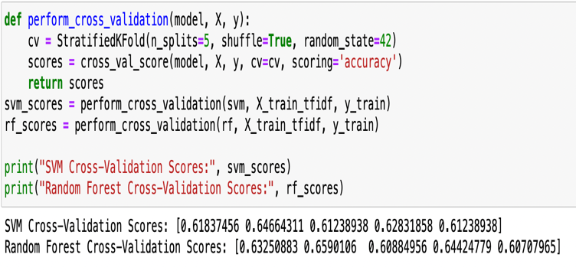
Experiments & Observations
Cross Validation
Random forest is a little inconsistent when compared to Support Vector Machine

Slide 17
Observations
Contextual Understanding: The BERT model's superior performance can be attributed to its ability to capture the contextual nuances in Twitter data. Unlike traditional models, BERT considers the relationships between words, resulting in more accurate sentiment predictions.
Ensemble Learning Strengths: The Random Forest Classifier showcased the strength of ensemble learning, providing a robust sentiment analysis model. The aggregation of decision trees contributed to its ability to handle diverse sentiments present in Twitter data.
Linear Separation by SVM: The SVM model, while slightly outperformed by BERT and Random Forest, demonstrated effective sentiment analysis through linear separation. Its simplicity and interpretability make it a viable choice for certain applications

Slide 18
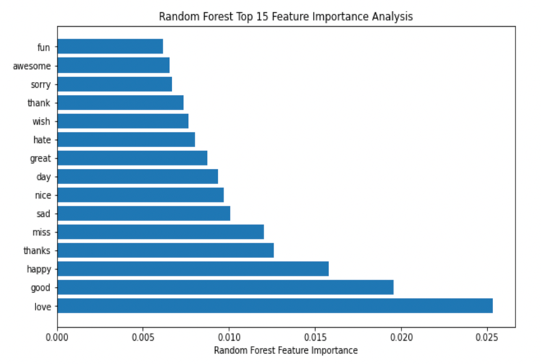
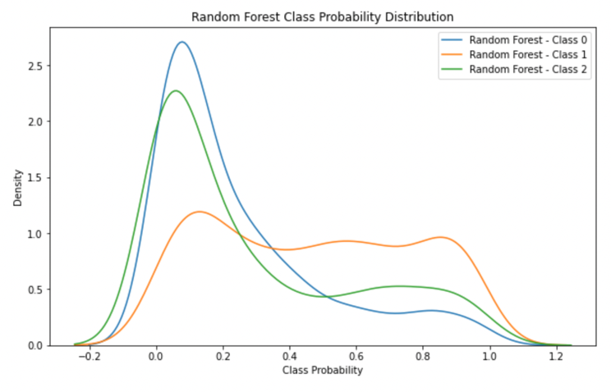
Experiments & Observations
Random Forest Classifier
Feature Importance Graph
Class Probability Distribution Graph

Slide 19
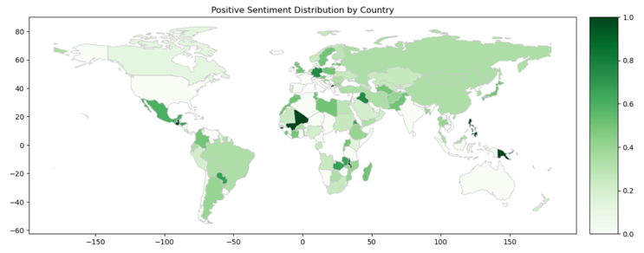
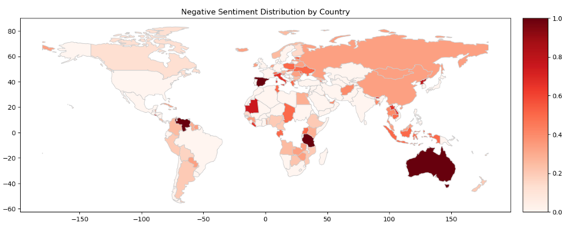
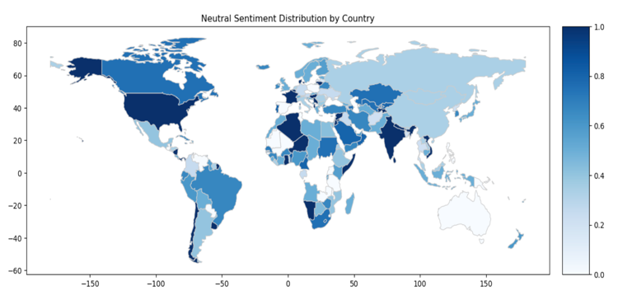
Experiments & Observations
Geographical Sentiment Distribution Analysis

Slide 20
Conclusions
BERT Model Excellence: The BERT model emerged as the most effective, boasting an impressive accuracy of 79%. Its nuanced understanding of contextual relationships within tweets sets it apart for sentiment analysis tasks.
AUC Analysis: BERT's superior performance is further underscored by its Area Under Curve (AUC) score of 90%, outshining SVM (80%), Random Forest (81%), and VADER (80%). This metric reinforces BERT's robustness in capturing sentiment nuances.
Computational Resources Consideration: While BERT exhibits unparalleled accuracy, it demands more computational resources and time compared to traditional models like Random Forest Classifier. In resource-constrained scenarios, Random Forest proves to be a pragmatic choice without compromising much on performance.
Negative Sentiment Predictions: The Random Forest Classifier, through class probability distribution analysis, demonstrates a notable strength in predicting negative sentiments with confidence. This finding provides valuable insights into the classifier's inherent tendencies.
Geographical Sentiment Variations: Geographical analysis reveals distinct sentiment distributions, with India exhibiting a more neutral sentiment distribution and Australia skewing towards negative sentiments. These regional variations add a layer of context to the sentiment dynamics observed.

Slide 21
Roadmap
As we conclude, the roadmap for future work involves addressing computational efficiency concerns with BERT through optimization strategies. Exploring advanced ensemble learning techniques and investigating domain-specific embeddings could enhance the performance of traditional models.
Furthermore, extending the geographical analysis to a global scale and incorporating real-time sentiment dynamics would provide a more comprehensive understanding of sentiment variations. The evolving landscape of social media sentiment warrants ongoing research to stay abreast of emerging trends and patterns.

Slide 22
References
Wang, H.; Can, D.; Kazemzadeh, A.; Bar, F.; Narayanan, S. A System for Real-time Twitter Sentiment Analysis of 2012 U.S.Presidential Election Cycle. In Proceedings of the ACL 2012 System Demonstrations, Jeju Island, Korea, 10 July 201
Koroteev, Mikhail. (2021). BERT: A Review of Applications in Natural Language Processing and Understanding. 10.48550/arXiv.2103.11943.
Adwan, O.; Al-Tawil, M.; Huneiti, A.; Shahin, R.; Zayed, A.A.; Al-Dibsi, R. Twitter sentiment analysis approaches: A survey. Int.J. Emerg. Technol. 2020,15, 79–93.
Gandhe, Ketaki & Varde, Aparna & Du, Xu. (2018). Sentiment Analysis of Twitter Data with Hybrid Learning for Recommender Applications. 57-63. 10.1109/UEMCON.2018.8796661.
Ahad, Abdul & Ayub Khan, Abdullah & Talpur, Mir Sajjad & Talpur, Hussain & Kayijuka, Idrissa & Yaşar, Erkan. (2022). Machine Learning Classifiers: A Brief Primer. 5. 63-68.
https://docs.python.org/3/library/re.html
https://scikit-learn.org/stable/modules/generated/sklearn.model_selection.train_test_split.html
https://scikit-learn.org/stable/modules/generated/sklearn.feature_extraction.text.CountVectorizer.html
https://scikit-learn.org/stable/modules/generated/sklearn.metrics.roc_auc_score.html
https://www.geeksforgeeks.org/feature-extraction-techniques-nlp/#
https://scikit-learn.org/stable/modules/generated/sklearn.feature_extraction.text.TfidfVectorizer.html
https://scikit-learn.org/stable/modules/generated/sklearn.model_selection.cross_val_score.html
https://keras.io/api/keras_nlp/models/bert/
https://scikit-learn.org/stable/modules/generated/sklearn.ensemble.RandomForestClassifier.html
https://www.nltk.org/_modules/nltk/sentiment/vader.html

